Slide 1

Google Play Store Review Analysis
An overview of the project's goals and objectives.

Slide 2

Selection of Machine Learning Algorithms
1
Supervised Learning
2
Unsupervised Learning
Utilizing labeled training data for prediction.
Developing insights from unlabeled data.

Slide 3

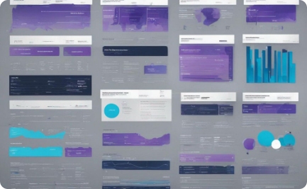

Overview of the Dataset and Its Features
Diverse App Categories
Data Representation
User Feedback
Understanding the variety of app types within the dataset.
Analyzing the structure and format of the dataset.
Exploring the significance of user ratings and reviews.

Slide 4

Data Preprocessing and Cleaning Steps
1
Data Cleaning
Eliminating missing or irrelevant data points.
2
Normalization and Encoding
Converting data into a standard format for analysis.
3
Outlier Detection
Identifying and handling outlier observations.

Slide 5
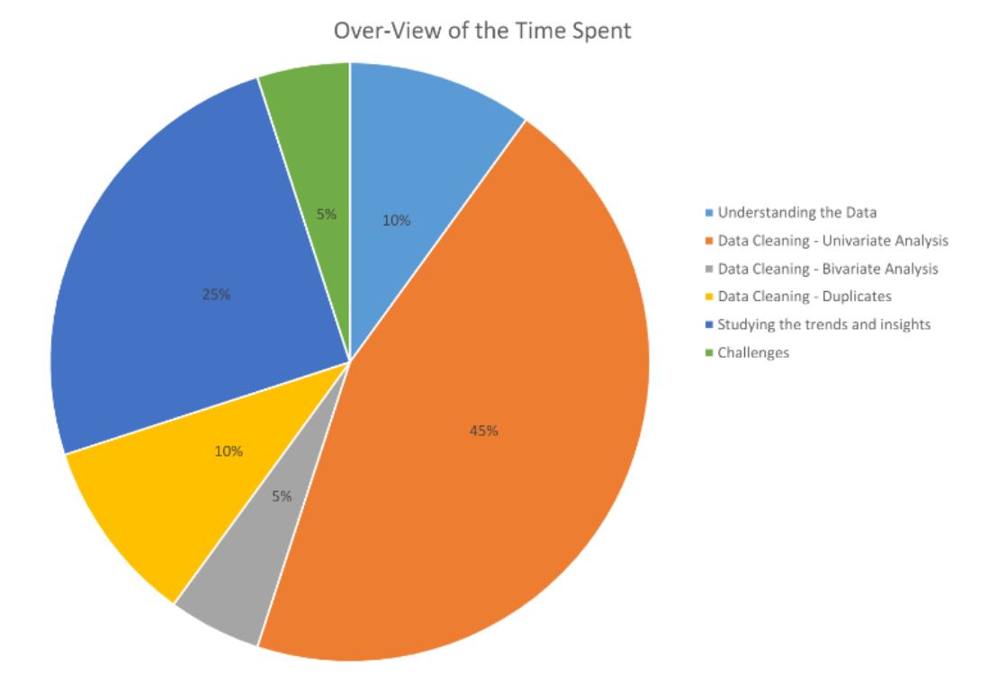
Overview of the Time Spent

Slide 6
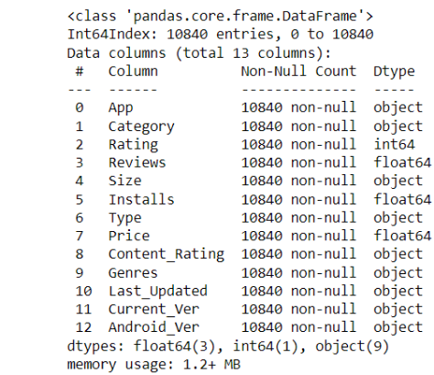
Data in the Dataset
Findings:
The number of null values are:
Rating has 1474 null values which contributes 13.60% of the data.
Type has 1 null value which contributes 0.01% of the data.
Content Rating has 1 null value which contributes 0.01% of the data.
Current Ver has 8 null values which contributes 0.07% of the data.
Android_Ver has 3 null values which contributes 0.03% of the data.

Slide 7
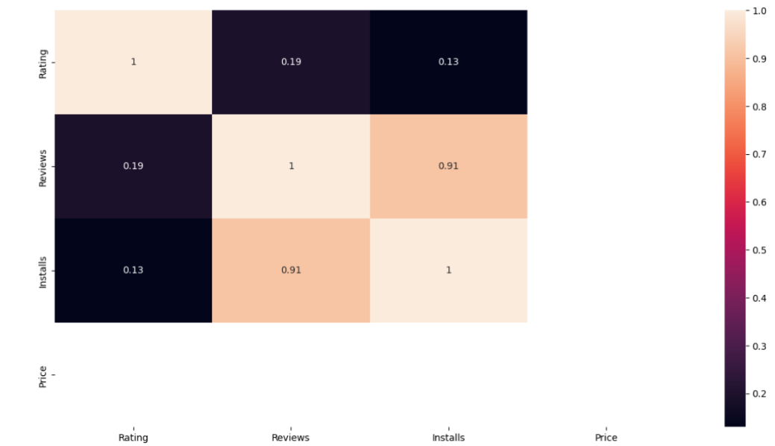
Data Cleaning - Bivariate Analysis
Findings:
42% of the Translated_Review, Sentiment, Sentiment_Polarity & Sentiment_Subjectivity has null values and we had dropped all of these values, as they were of no value to the analysis.

Slide 8
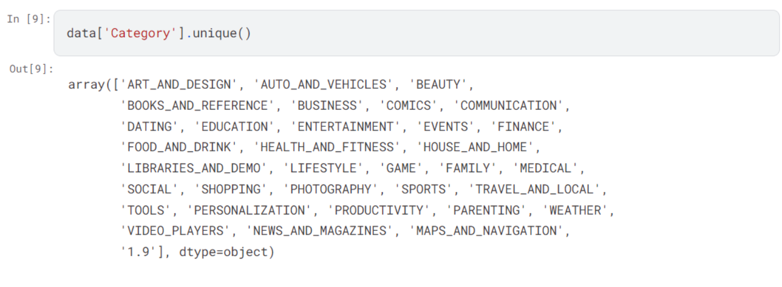
Normalization
check the number of duplicates based on the App name

Slide 9



Exploratory Data Analysis and Insights
Data Visualization
Box Plot Analysis
Correlation Study
Visual representation of key dataset insights.
Identifying patterns and market trends.
Investigating relationships between variables.

Slide 10
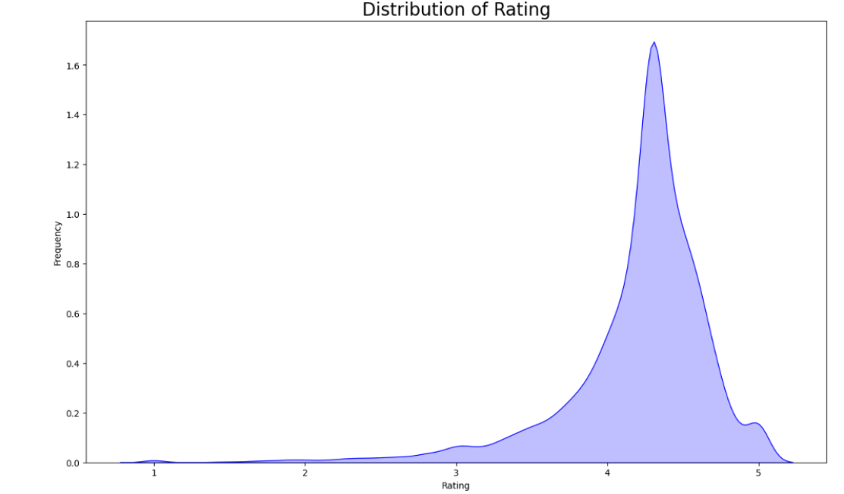
Distribution of the ratings of the apps
Findings:
From the above graph we can come to a conclusion that most of the apps in google playstore are rated in between 3.5 to 4.8

Slide 11
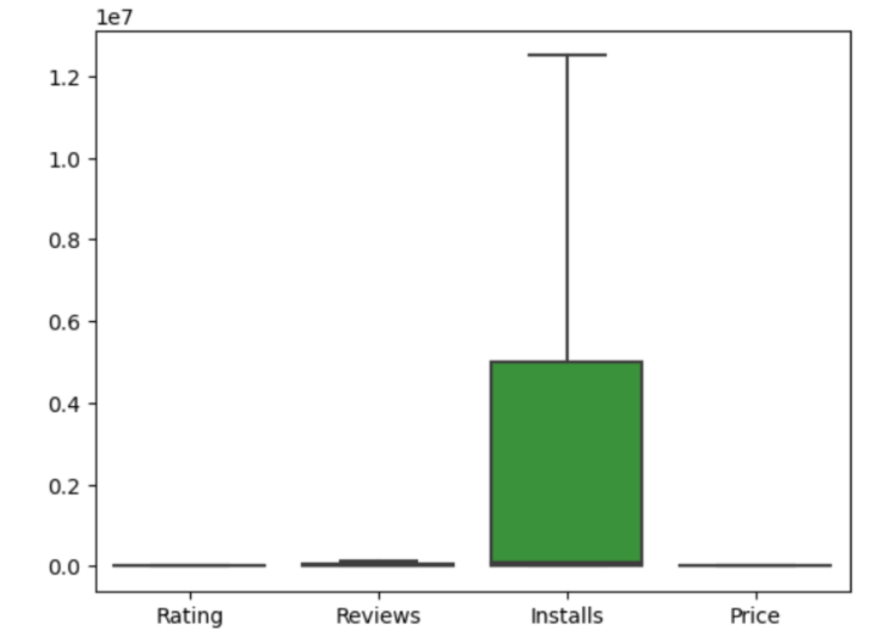
Box Plot Analysis

Slide 12
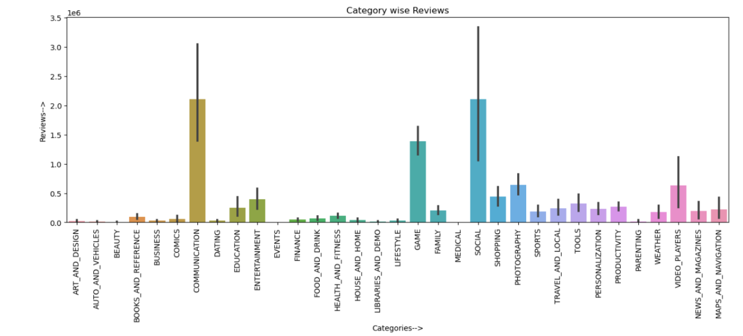
Bar Plot Analysis

Slide 13
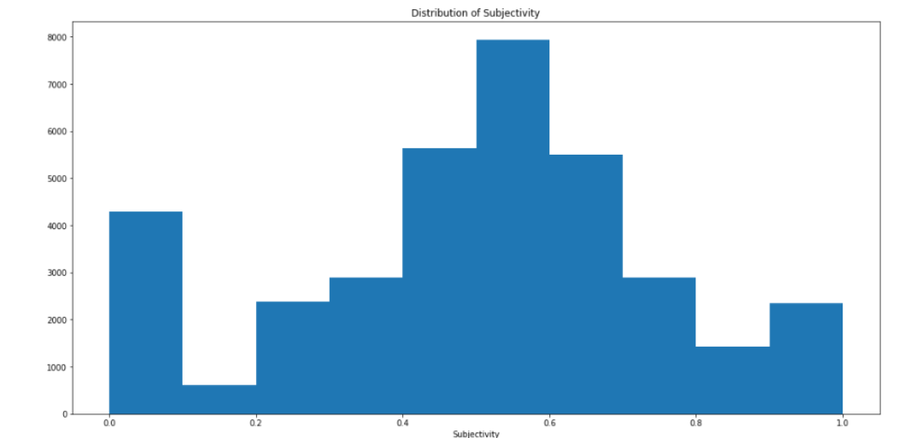
Histogram of Subjectivity:
It can be seen that maximum number of sentiment subjectivity lies between 0.4 to 0.7. From this we can conclude that maximum number of users give reviews to the applications, according to their experience.

Slide 14
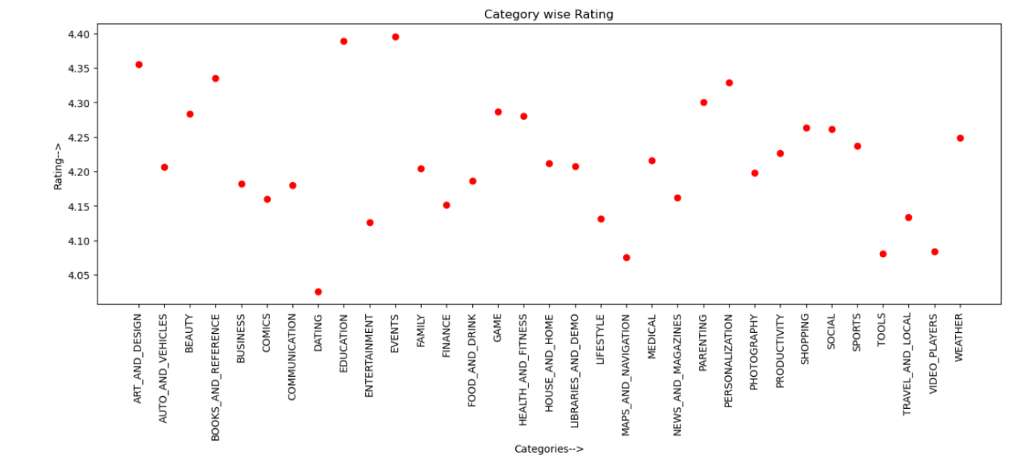
Exploratory Data Analysis
Category wise Rating

Slide 15
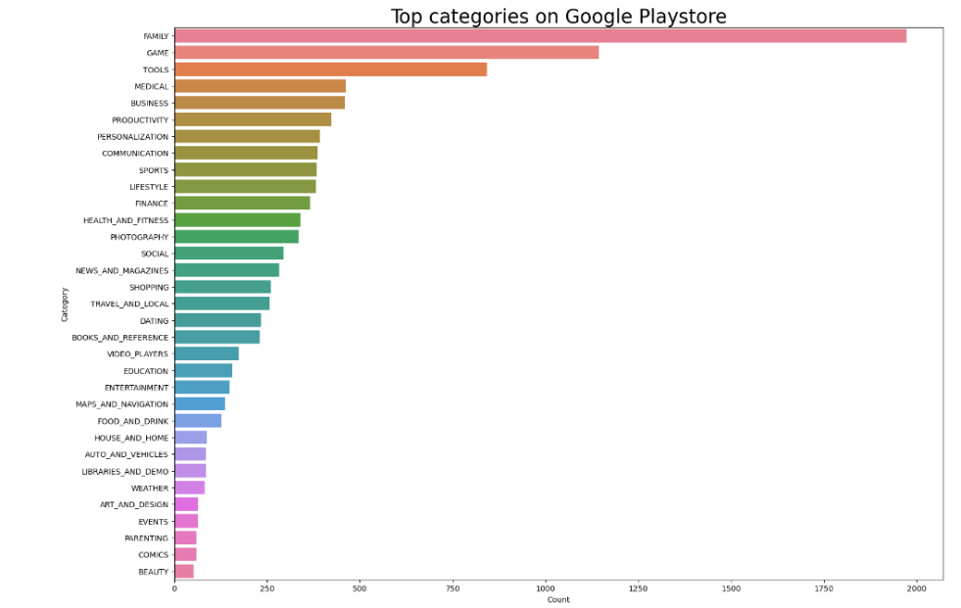
Top Categories on PlayStore
Findings:
So there are all total 33 categories in the dataset From the above output we can come to a conclusion that in playstore most of the apps are under FAMILY & GAME category and least are of EVENTS & BEAUTY Category.

Slide 16
Model Training and Evaluation
95%
85%
Training Accuracy
Validation Accuracy
Measure of the model's accuracy on the training data.
Assessment of the model's performance on unseen data.

Slide 17

Challenges and Limitations
Data Quality
Scalability
Addressing issues related to incomplete or inaccurate data.
performing and efficiency of the model with large datasets.

Slide 18
Conclusion
Google Play Store reviews dataset provides a comprehensive view of user sentiments and preferences across a wide range of apps. With its vast collection of reviews, it offers valuable insights into user experiences, satisfaction levels, and emerging trends. While acknowledging potential biases and limitations inherent in user-generated content, this dataset remains a powerful resource for app developers, marketers, and researchers aiming to optimize user engagement and satisfaction in the ever-evolving app ecosystem.

Slide 19

Reference

Slide 20

Thank You!

